Slide 1
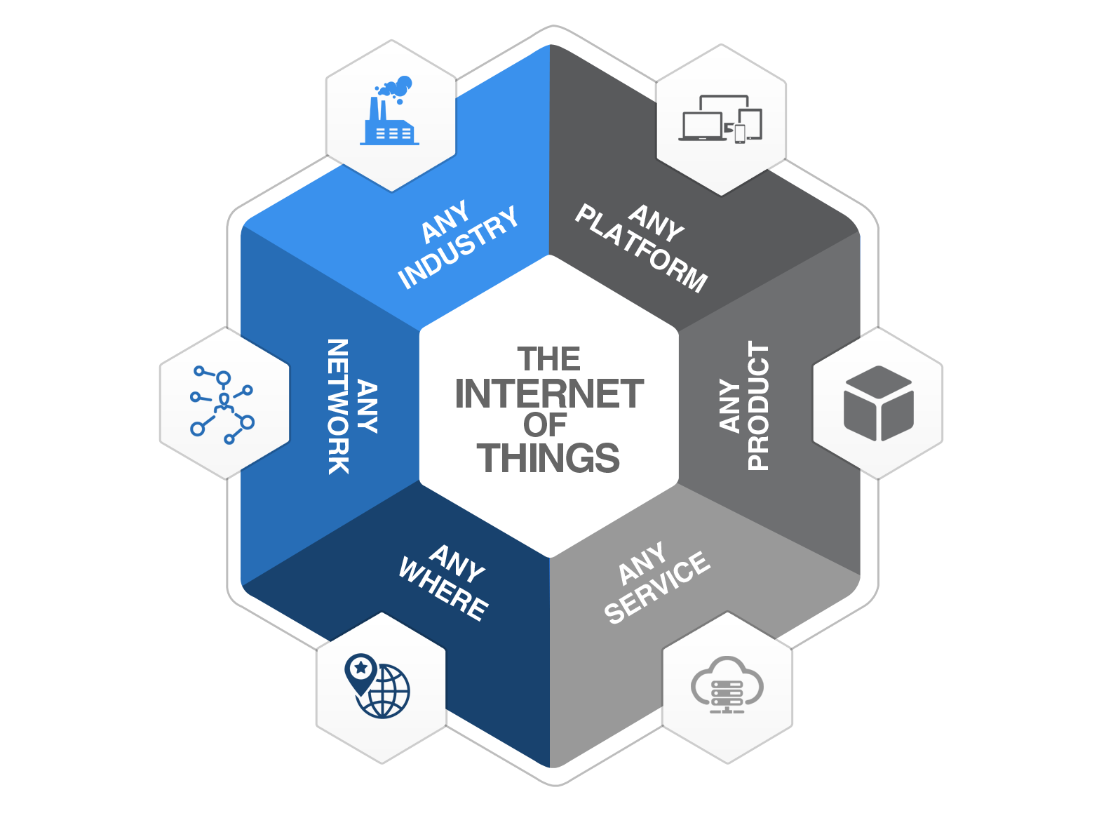

Module 3
CLOUD AND DATA ANALYTICS FOR IOT
Cloud: Types of Cloud - loT with Cloud challenges - Selection of cloud for loT applications - Fog and Edge computing for loT - Cloud security aspects for loT applications. Data Analytics for IoT: Overview of Hadoop ecosystem – MapReduce architecture – MapReduce Job Execution – MapReduce Schedulers. Case study: Internet of Medical Things (IoMT)
Watch this video: Click Here
Module 2

Slide 2
22IO602-Internet of Things
Introduction:
What is structured data?
Characteristics of structured data
Examples
What is unstructured data?
Characteristics of unstructured data
Structured Vs Unstructured Data
Activity
Module 3

Slide 3
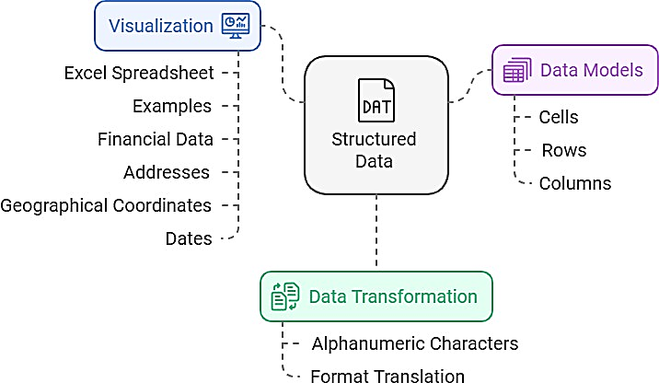
23ITC01-Internet of Things
What is structured data?
Structured data is usually composed of alphanumeric characters translated from native format into a predefined format before being fed into a predetermined data model. This data model stores the structured data in cells, rows, and columns.
A good way to visualize structured data is to think about how an Excel data sheet looks with its cells, rows, and columns.
Examples of structured data include financial data, addresses, latitude and longitude, and dates.
Module 3

Slide 4
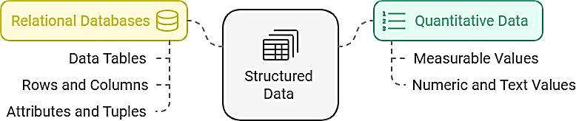
23ITC01-Internet of Things
Characteristics of structured data
Some of the key characteristics of structured data include:
Quantitative data: Structured data is often referred to as quantitative data because it contains measurable numeric or text values that can be counted or analyzed (e.g., numbers, dates).
Relational databases: Structured data is stored in relational databases, meaning that the data is stored in data tables which are composed of rows and columns.
Each column holds a certain kind of data (sometimes called an attribute), and each cell in the column holds the actual value.
Each row (sometimes called a tuple) contains data pertaining to an individual entity.
Module 3

Slide 5
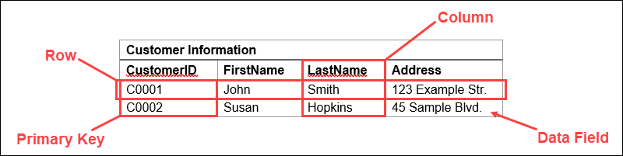
23ITC01-Internet of Things
Examples
In the example below, the table Customer Information contains the columns (or attributes) CustomerID, FirstName, LastName, and Address.
Each row is made up of cells which contain information about each specific customer.
This data table illustrates how predefined relationships are created by the predefined model the structured data is housed within (e.g., the attributes of First Name, LastName, Address assigned to CustomerID).
Module 3

Slide 6
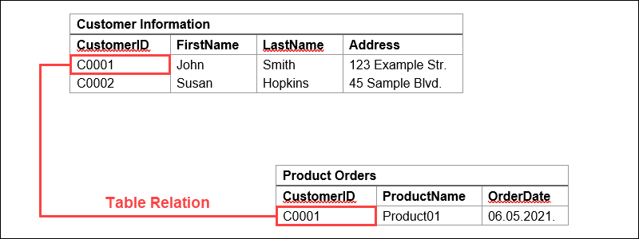
23ITC01-Internet of Things
Further, additional relationships can be created between tables using the unique identifier found in each row, called a primary key.
Module 3

Slide 7
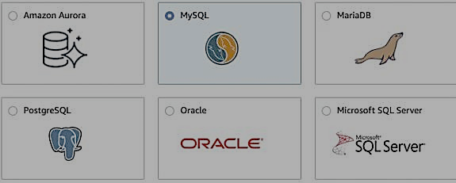
23ITC01-Internet of Things
RDBMS (relational database management systems): RDBMS are programs used to build and manage relational databases.
The RDBMS is responsible for applying the logic to ensure ingested structured data is in the
correct format as it is ingested into the database and is placed in the correct table(s), columns, and rows.
SQL (structured query language) programming language is the primary language used by RDBMSs. Common types of RDBMS include:
Microsoft SQL Server
Oracle DB
Amazon Aurora
MySQL (opensource)
PostgreSQL (opensource)
SQLite (opensource)
Module 3

Slide 8
23ITC01-Internet of Things
Structured data examples
Accounting: Structured data helps accounting firms manage transactions, prepare statements, and file taxes efficiently.
CRM: CRM systems use structured data to manage customer info, loyalty programs, and relationships.
SEO: Structured data (e.g., schema markup) boosts search engine rankings by improving content understanding.
Data Analytics: Analysts use structured data for detailed analysis and pattern discovery, driving informed decisions.
Machine Learning: ML algorithms leverage structured data for quick, efficient analysis, performing tasks like classification and regression.
Module 3

Slide 9
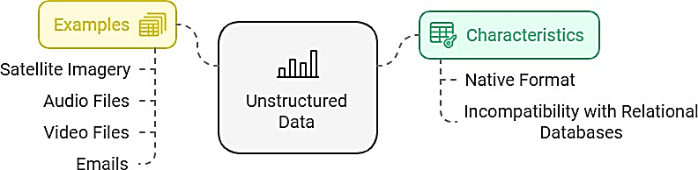
23ITC01-Internet of Things
What is unstructured data?
Unstructured data is data that cannot be analyzed or counted through traditional analytical methods.
Unstructured data is stored in its native format, so it cannot be stored in a relational database which requires a predefined data model.
Examples of unstructured data include satellite imagery, audio files, video files, or even emails.
Module 3
Module 3

Slide 10
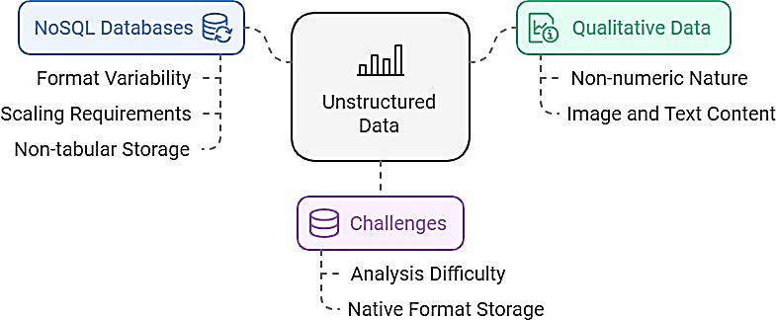
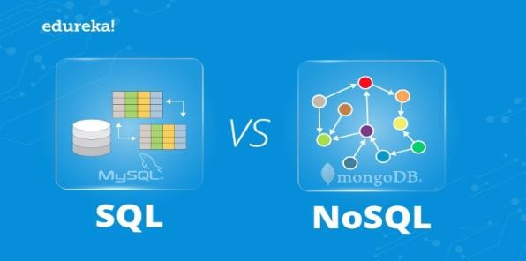
23ITC01-Internet of Things
Characteristics of unstructured data
Qualitative data: Unstructured data is often referred to as qualitative data because it is nonnumeric, can contain images, and can be text-heavy in nature.
In addition, this data is very difficult to analyze as unstructured data is stored in its native format and doesn't lend itself to the use of traditional analytics tools.
NoSQL databases: Unstructured data is highly variable in format. As a result, it requires a storage vehicle that is optimized for the data format being housed, as well as the scaling requirements needed to efficiently access that data (e.g., text files, videos, scanned documents).
NoSQL databases, named such because they don't employ the SQL programming language, are non-tabular, and store data differently than relational tables.
Module 3

Slide 11
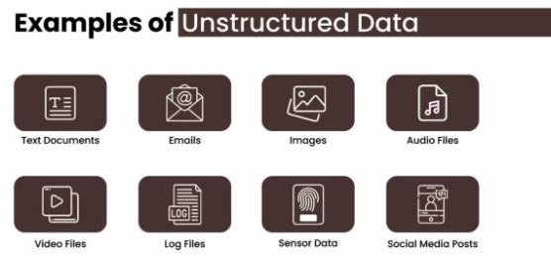
23ITC01-Internet of Things
Unstructured Data Examples
Social Media: Contains semi-structured data (e.g., profiles) and unstructured data (e.g., messages).
Email: Often semi-structured; email content, including text, video, and images, is unstructured.
Text Files: Documents like Word, PDFs, and presentations are unstructured data.
Survey Responses: Open-ended responses or "liked" photos are unstructured data.
Scientific Data: Includes unstructured data from fields like weather, space exploration, and medical data.
Machine and Sensor Data:IoT devices and system logs generate vast amounts of unstructured data.
Module 3

Slide 12
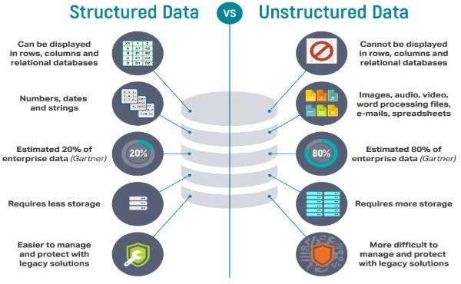
23ITC01-Internet of Things
Structured Vs Unstructured Data
Module 3

Slide 13

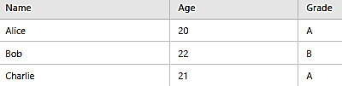
23ITC01-Internet of Things
Activity: Structured Data
Task 1: A list of student names, ages, and grades. Example: Add "David", 23, "B
Key: It is organized into a table and can be easily manipulated.
Activity: Unstructured Data
Task 2: A block of text (e.g., an email).
"Hi, I hope you are doing well. I wanted to let you know about the upcoming meeting on Friday at 10 AM. Please confirm your attendance. Thanks!
Key: To extract useful information from the text.
Module 3

Slide 14
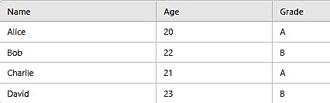
23ITC01-Internet of Things
Answer Task 1:
Answer
Task 2: Extract key information.
Date: Friday at 10 AM
Action: Confirm attendance
Module 3

